Slide 1
Python stock tracking program
Jeimy adams
4/18/2022

Slide 2
PYTHON STOCK TRACKING PROGRAM
PROJECT INTRODUCTION
PROCESS FOR STOCK TRACKING PROGRAM
SUMMARY/CAREER DEVELOPMENT
CONCLUSION

Slide 3
Project intro and it’s environment
Project’s objective was to develop a stock program tracker. While using Python object-oriented concepts. That allow the user to save, retrieve stock data, and create charts using Python libraries.
An environment had to be set by downloading Spyder IDE
Then created a test prices program called prices.py to make sure IDE was working properly

Slide 4
Testing environment Program
Screen shot of Python program prices.py running successfully in Spyder
Notes:
m1

Slide 5
Creating the classes
Created a Unified Modeling Language diagram (UML) with Microsoft Visio
New file was created as stock_class.py and code was written for both Stock and Daily_Data
Tested the file for accuracy by running a pre-written unit test
Objective: To create a class diagram, create classes, and run a unit test for accuracy

Slide 6
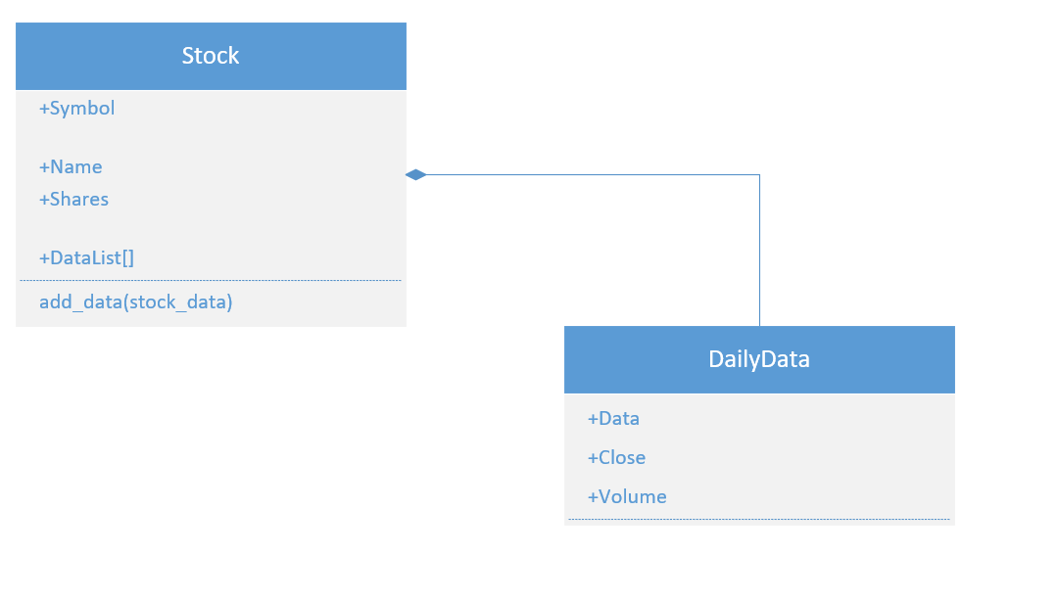
ClassES Diagram
UML Diagram using Visio
Stock file contains symbol, name, shares and DataList
Daily Data file contains data, close, and volume
Daily_Data is the data type in the Stock class. A connector was used to join both classes together
Notes:
m2

Slide 7
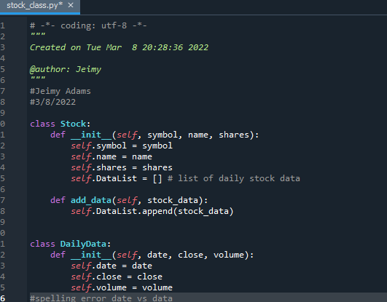
Class Code
Screen shot of stock_class.py file
Code of Stock and Daily_Data

Slide 8
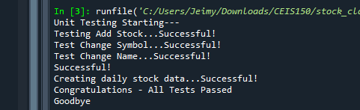
Unit Test
Screen shot of successful unit test run
Key indicator “Successful !”
Notes:
M2

Slide 9
What was learned ?
When I was running the unit test, it failed four times. Once I check the code, I found that I had typed data not date
Learned also the importance of keeping files in the same directory
Learned the importance of pre organizing your code by using diagrams
Learned how to use Microsoft Visio

Slide 10
Creating a console- based interface
Create a menu-driven user interface to add, list, delete stocks, track price, and volume history
Create functions to handle menu items
Objective: Focus on creating a console-based interface for working stocks and the stock price history

Slide 11
Adding a Stock
Screen shot of code working when adding a stock
Apple Inc was an example of adding a stock for 25 shares

Slide 12
Code for Listing 3 Stocks
Screen shot of 3 stocks being listed
Apple Inc for 25 shares
Google for 100 shares
Facebook (Meta platform) for 150 shares

Slide 13
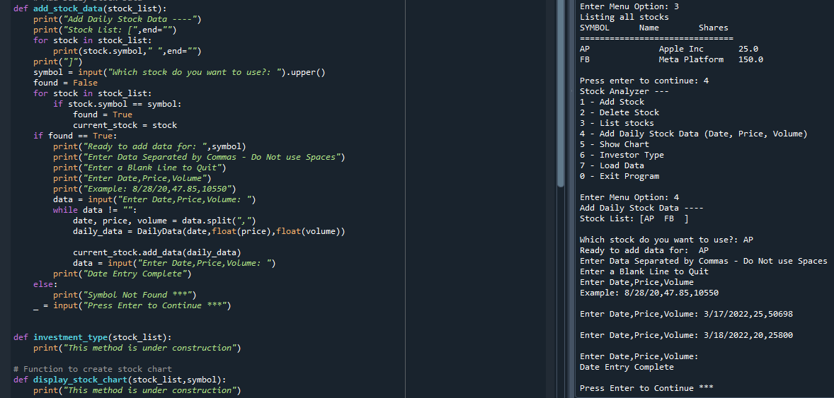
Code for Daily Data
Screen shot of adding daily stock data code
After listing our stock list, we added our daily stock data such as date, price, and volume

Slide 14
What was learned ?
Learned what Stubs were in programming and why they are very useful
When copying code from stubs I noticed indentations were not picking up causing error in my code
Learned that you can create an object from a class and the relationship between classes

Slide 15
Class inheritance
Implement inheritance in the stock program
Create three classes (retirement, traditional, and robo)
Run unit test
Objective: Create two or more classes based off the base class Stock and Daily_Data

Slide 16
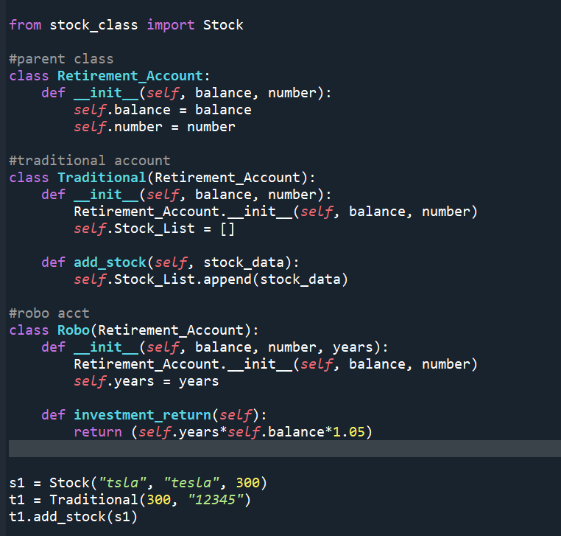
Inherited classes
Screen shot of inherited classes
From stock_class we import Stock. Retirement_Account is the parent class. The added classes are our Traditional and Robo account
In the Traditional class we can see where we pass the Retirement_Account balance

Slide 17
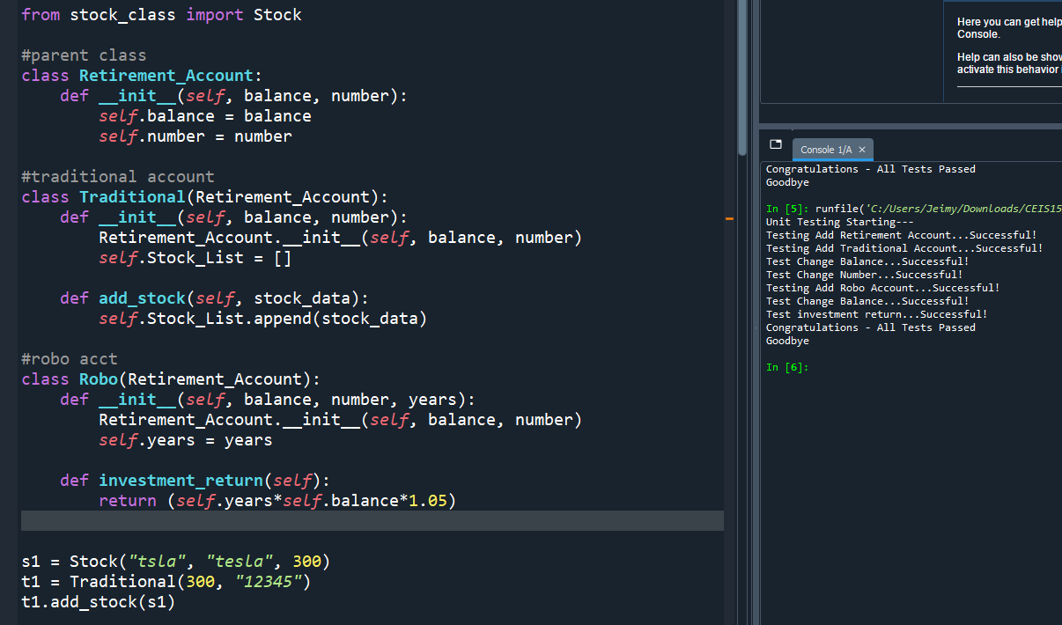
Unit Tests
Screen shot of successful unit test
Unit test checked for errors in created stock, retirement, traditional, and robo account

Slide 18
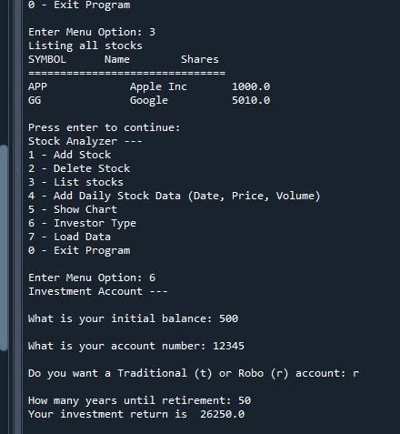
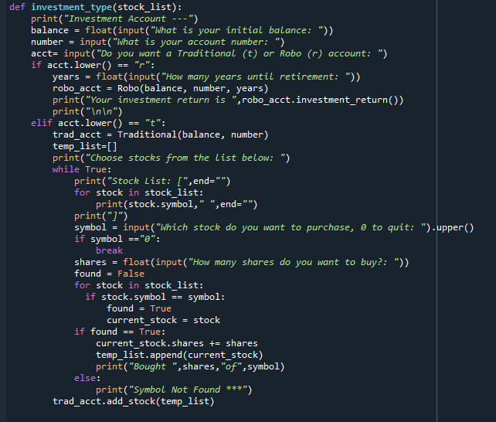
Stock menu program
Screen shot of adding an investor type to the stock menu program
My initial balance is $500 for Robo, account # 12345, after 50 years I should have an investment return of $26,250.0

Slide 19
What was learned ?
Learned more about child and parent class relationships
Learned you can have more than one class
Learned to create object based derived classes
Accessing base class attributes

Slide 20
Creating a chart using matplotlib
Objective: Use matplotlib to create a chart visual showing stock prices over time
Used Python matplotlib library to display stock chart

Slide 21
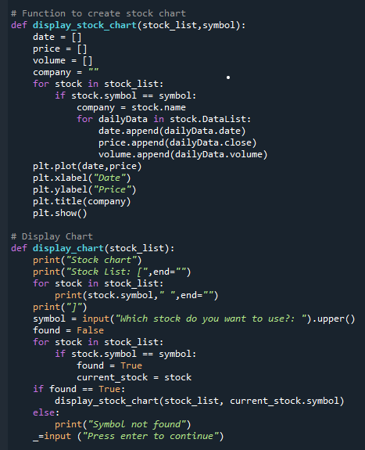
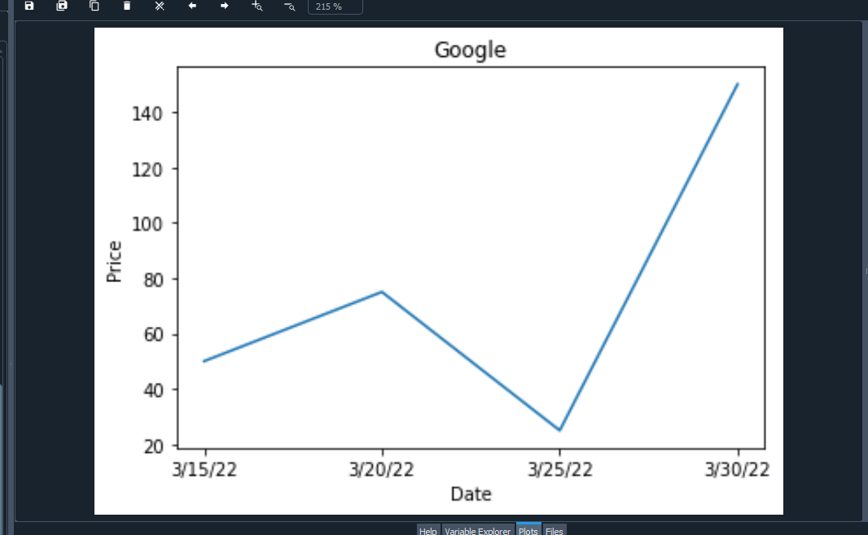
Chart for stock price history
Screen shot of price history for Google stock successfully displaying

Slide 22
What was learned ?
Stock investors use charts to visualize stock prices over time
Python has extensive libraries to enhance Python programming
Challenge for this module was the x and y label code was not working properly had to restart a few times

Slide 23
Working with files
Objective: Focus on saving data and reading data from files
Used the CSV library to import data from Yahoo Finance
Read data from file

Slide 24
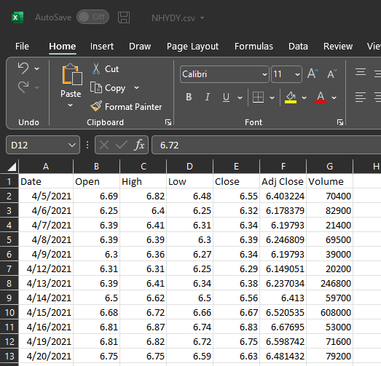
CSV File
Screen shot of downloaded CSV file from Yahoo Finance
Stock downloaded is Norsk Hydro ASA one of the top aluminum extruders
Range of stock is year to date 4/5/2021-4/5/2022

Slide 25
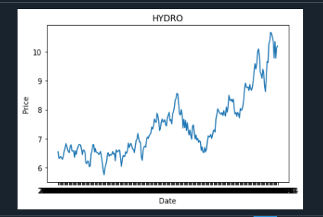
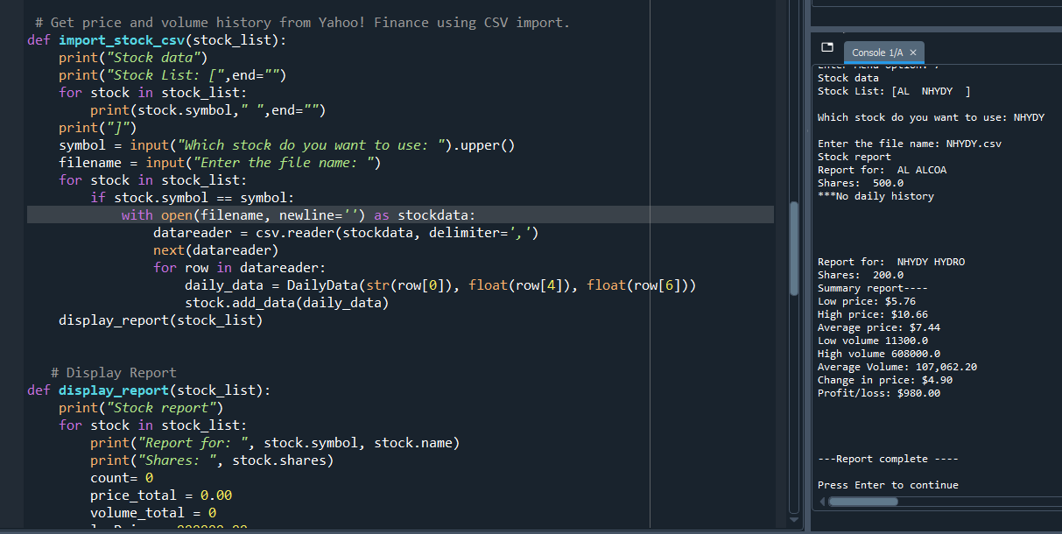
Importing data
Screenshot of the historical data import for Hydro stock
Here we see the low/high price, low/high volume/ change in price and profit/loss
Chart is the visual for Hydro’s one year data

Slide 26
What was learned ?
In this module there was a lot of code that it was very important to make sure spelling and indentation was accurate
Learned that Python works with many different types of files and use libraries to enhance programming
Learned the importance of CSV files in the same folder for the code to work properly

Slide 27
Creating a graphical user interface
Objective: Implement a graphical user interface for our stock tracker while using tkinter library
Display stock added into GUI with history and report tab

Slide 28
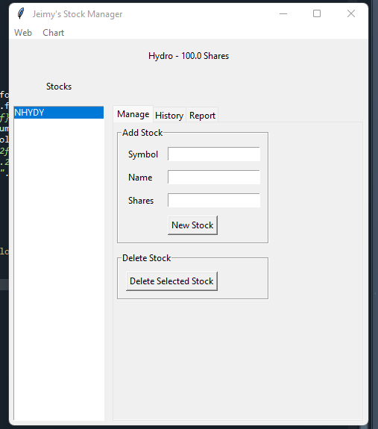
Stocks in GUI
Screen shot of Hydro stock successfully working
Added the symbol NHYDY, the name of the company, and the number of shares, 100.

Slide 29
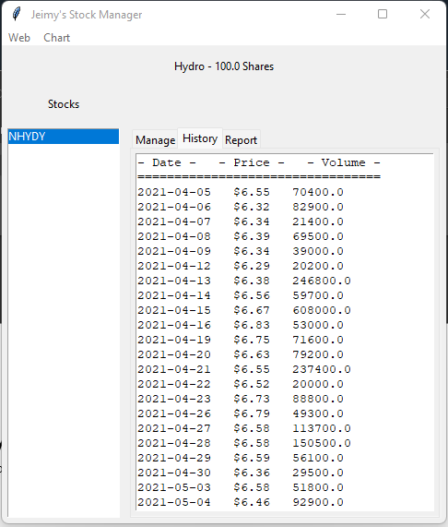
History Tab
History tab shows us the data that was imported from the CSV file download from Yahoo Finance
We see date, price, and volume from 4/5/2021-4/5/2022

Slide 30
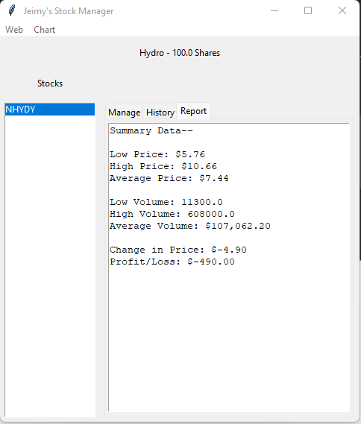
Report Complete
Report shows the data summary of Hydro stock for its low/high prices, low/high volume, change in price, and profit/loss

Slide 31
What was learned ?
Learned the difference from text-based menu to a GUI and how it comes to life
Learned more about tkinter library
Learned to work with different methods like display_stock_data(), add_stock(), and display_chart()
One challenge in this module was the importance of the stock name needing to be the same as the CSV file download

Slide 32
Summary/career development
I learned more about Python when it came down to the object-oriented programing concepts. Learning how to structure a program is key to programming. As well as the importance of these properties working together properly.
I really enjoyed the end being able to see the code come to life with the guided user interface. Seeing it all in action was well worth the work put into this project.
I also enjoyed researching the cool stocks Yahoo Finance has and seeing these stocks history into a chart. That was neat.
Some of my skills became stronger, like my attention to detail and accuracy. Along the way I learned new ways of thinking when structuring a program. Python programming is language that I will continue to learn and become certified along my software development career.

Slide 33
THANK YOU
Jeimy Adams

